Slide 1


UNIT 3: Home sweet home
Unit 3 – Roundup & Writing rules 3

Slide 2
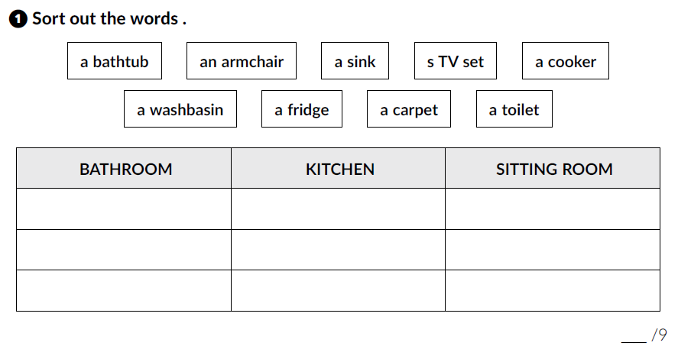
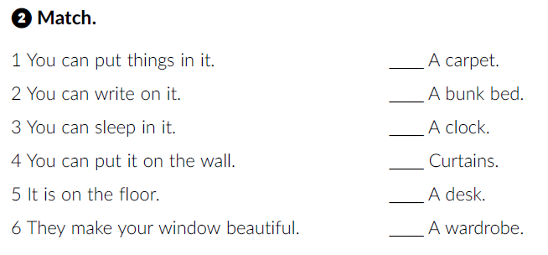
Workbook, p. 37-38.
a bathtub
a sink
an armchair
a washbasin
a cooker
a TV set
a toilet
a fridge
a carpet
5
3
4
6
2
1

Slide 3
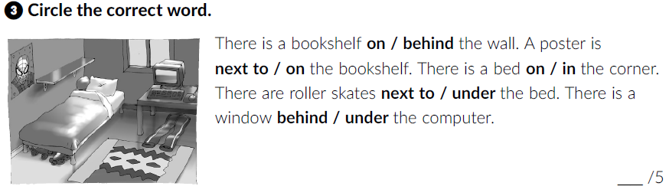
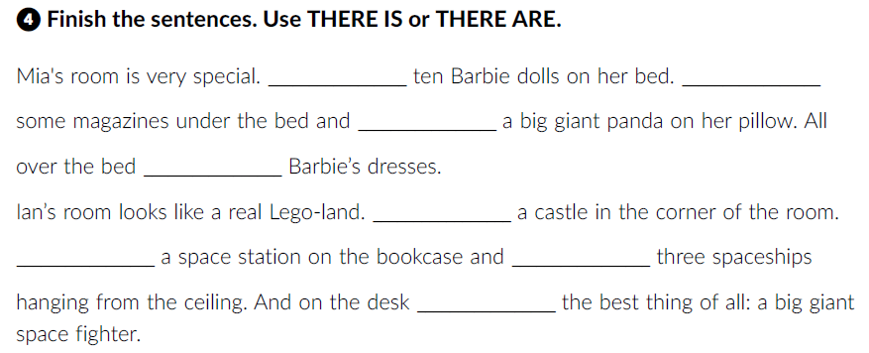
There are
There are
there is
there are
There is
There is
there are
there is

Slide 4
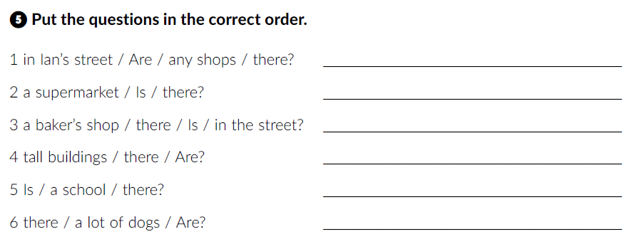
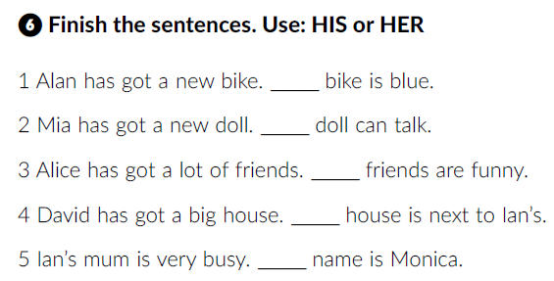
Are there any shops in Ian’s street?
Is there a supermarket?
Is there a baker’s shop in the street?
Are there tall buildings?
Is there a school?
Are there a lot of dogs?
His
Her
Her
His
Her

Slide 5
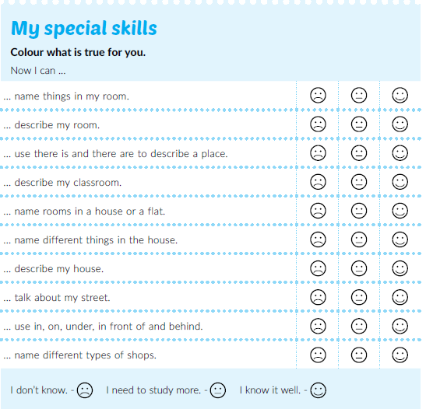
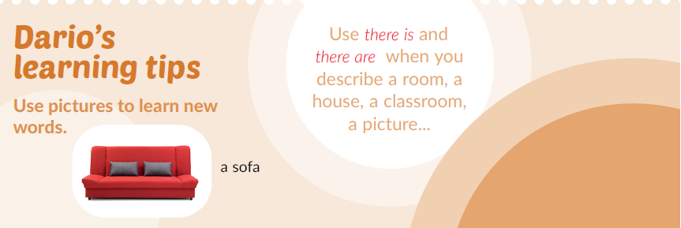
Read Dario’s learning tips.

Slide 6
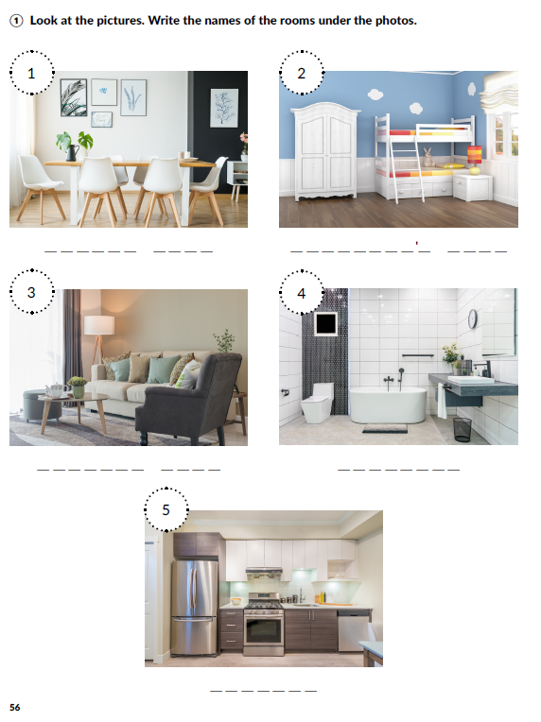
dining room
children’s room
What furniture is there? Describe the rooms in the photos.
living room
bathroom
kitchen

Slide 7
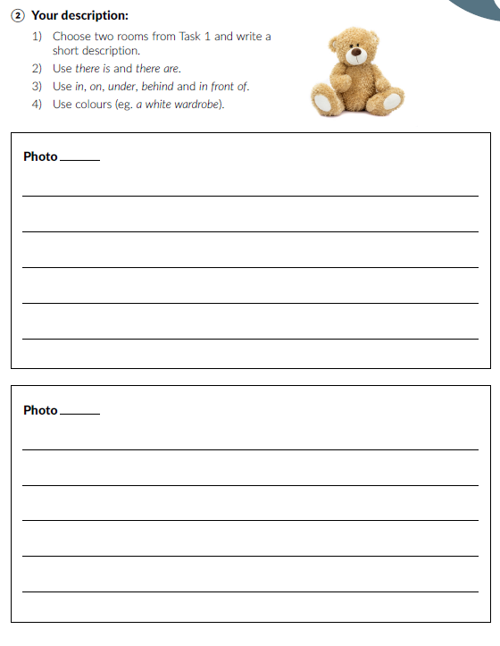
Read the instructions and write the descriptions.

